Slide 1


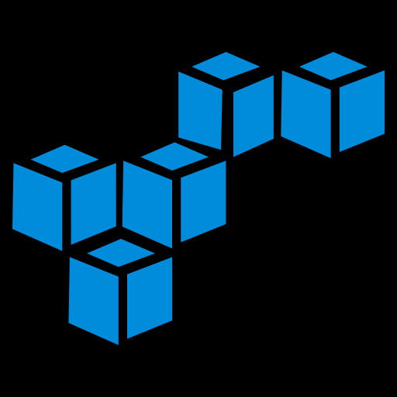
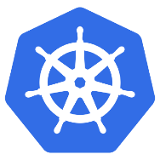

Webinar - Scalable MicroServices with Kubernetes
September 2017

Slide 2
Agenda
What Are MicroServices?
Difficulties of doing MicroServices
Pods
Service
Demo
Royal Cyber Overview
Service Discovery
Key Benefits
Kubernetes
Deployment
Q&A

Slide 3
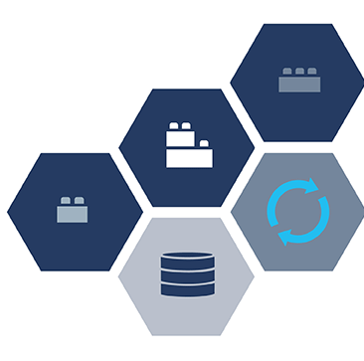
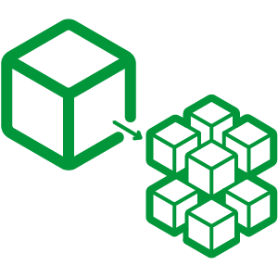
MicroServices

Slide 4

What Are MicroServices?
MicroServices are small, autonomous services that work together.
Notes:
Most programmers spend lots of time to deal with a user experience that is equal parts out-of-date documentation, XML configuration files, arcane error messages, and frantic, rage-driven Google searches.
Going through software installation process in all environments such as development, testing, production.
Even though the software is running successfully in one environment, huge percentage of bug arises when the software is tried to run in other environments.
Packaging the code into Virtual Machine (VM) images, incur a lot of performance overhead, which causes problems in the production environment, and they use a lot of resources and are slow to start.

Slide 5
Key Benefits
Technology Heterogeneity
Resilience
Scaling
Ease of Deployment
Organizational Alignment

Slide 6
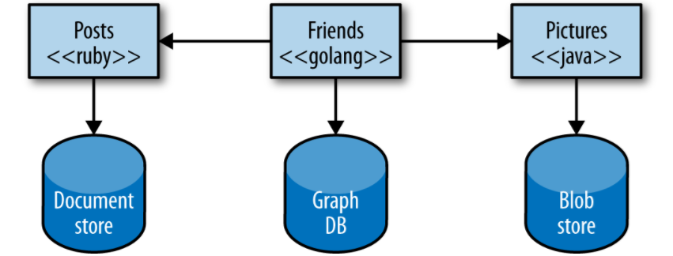
Technology Heterogeneity
System composed of multiple, collaborating services can have different technologies inside each one
Helps picking right tool for each job instead of having a standardized, one-size-fits-all approach
MicroServices can allow easily embrace different technologies
Notes:
With a system composed of multiple, collaborating services, we can decide to use different technologies inside each one.
Helps picking right tool for each job, rather than having to select a more standardized, one-size-fits-all approach that often ends up being the lowest common denominator.

Slide 7

Resilience
In a monolithic service, if the service fails, everything stops working
Monolithic systems run on multiple machines to reduce chances of failure
MicroServices permits building systems that handle the total failure of services and degrade functionality accordingly

Slide 8
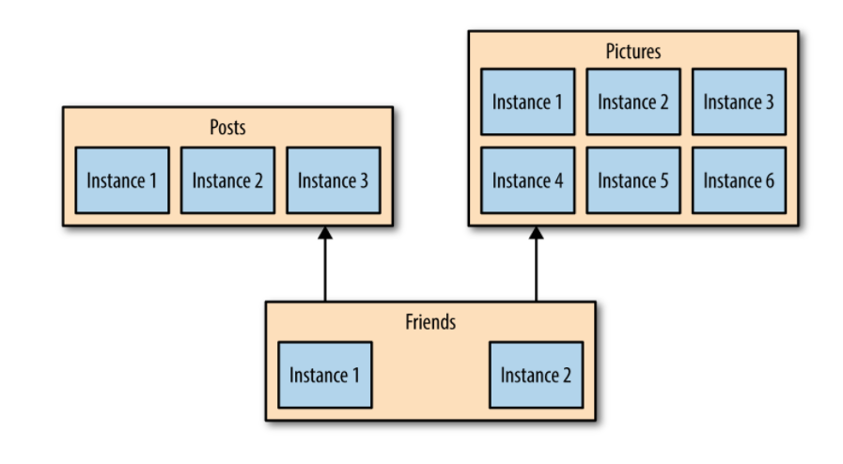
Scaling
With a large monolithic service everything is scaled together
With smaller services only required services are scaled
Permits running other parts of the system on smaller, less powerful hardware

Slide 9

Ease of Deployment
One-line change to a million-line-long monolithic application requires the whole application to be deployed in order to reflect the change
With MicroServices, change to a single service can be deployed independently from rest of the system

Slide 10

Organizational Alignment
Problems:
Large teams
Large codebases
Distributed Teams
Smaller teams & smaller codebases = More Productivity
MicroServices allows:
Better alignment between architecture and the organization
Minimize the number of people working on any one codebase
Helps achieve the sweet spot of team size and productivity
Notes:
Many of us have experienced the problems associated with large teams and large codebases. These problems can be exacerbated when the team is distributed. We also know that smaller teams working on smaller codebases tend to be more productive.
MicroServices allow us to better align our architecture to our organization, helping us minimize the number of people working on any one codebase to hit the sweet spot of team size and productivity.

Slide 11
Difficulties of doing MicroServices
Scaling
MicroService to MicroService communication
Load balancing among different instances

Slide 12

Kubernetes

Slide 13
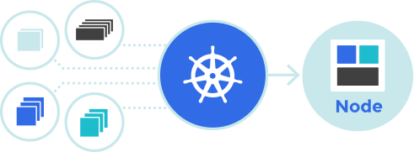
Kubernetes
An open-source system for automating deployment, scaling, and management of containerized applications

Slide 14
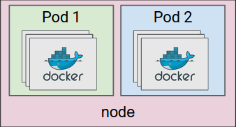
Pods
Smallest deployable units of computing that can be created and managed in Kubernetes.
Kubernetes Pods
Collections of containers that co-scheduled

Slide 15

Deployment
Describe a desired state in a Deployment object
Deployment controller changes the actual state to the desired state at a controlled rate

Slide 16
Service
Kubernetes Service is an abstraction which defines a logical set of Pods
Use it to load balance among Pods
apiserver
Client
Kube-Proxy
Service IP
(iptables)
Node
Backend Pod 1
labels: app = MyApp
port: 9376
Backend Pod 2
labels: app = MyApp
port: 9376
Backend Pod 3
labels: app = MyApp
port: 9376

Slide 17
Service
Service A
Service B
Pod A
1
Pod A
2
Pod A
3
Pod B
1
Pod B
2
Deployment A
Select POD A
3 Instance
Deployment B
Select POD B
2 Instance

Slide 18

Service Discovery
Kubernetes offers a DNS cluster add-on Service that uses skydns to automatically assign DNS names to other Services

Slide 19

DEMO

Slide 20
Demo
Services A
Services B
/ hai
/serviceB
/ hai

Slide 21
Demo
Create Service A
Create Service B
Create Deployment A
Create Deployment B
Scale Service A
Bring one Pod down
Call service B from Service A (discovery)
Load balancing with in Pods

Slide 22


Questions & Answers

Slide 23


Royal Cyber Overview

Slide 24



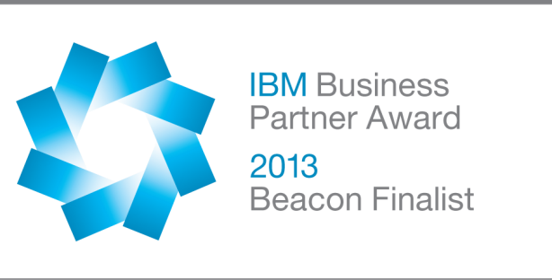




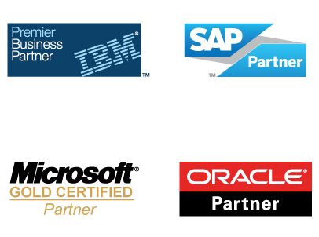


About Us
Awards
Over 10 Technology and Solutions Awards since 2009 including Business Agility, Customer Integration and Digital Experience, the first ever Beacon Laureate for Business Agility
20+
Technology Accelerators
550+
Technical Certifications
Years in Business
15+
Offices
14
5-Years Compound Annual Growth Rate
Fortune Companies
Serving Fortune companies
About Royal Cyber
Royal Cyber commenced operations in year 2002 as a specialized technology provider, headquartered out of Naperville, IL and further striding in as a software deployment service provider by partnering with IBM as a Business Authorized trainer and Microsoft Certiﬁed Gold Partner. Today we stand tall as a One Stop Shop for all your IT needs.
Global Presence
US, Canada, UK, UAE, S. Africa, Australia, KSA, Mexico, India

Slide 25


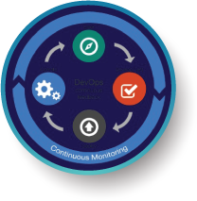

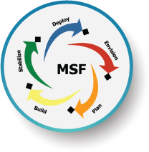


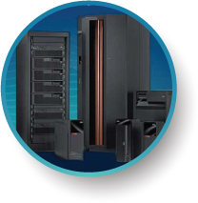
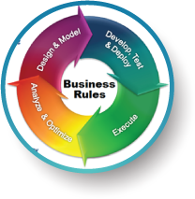
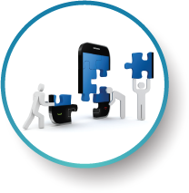
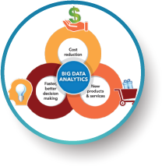

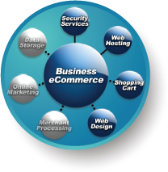
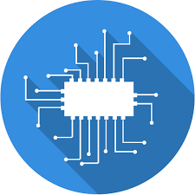
Expertise & Line of Business
Microservices
Cloud Solutions
DevOps
Integration Services (Middleware Integrations )
Asset Management Solutions
Microsoft Solutions
Business Process & Rules
Management
Enterprise Modernization
AS400 Services, Solutions
Mobile Solutions
Analytics and Big Data
Enterprise Marketing Management
Commerce
(e - Commerce)
Artificial Intelligence

Slide 26


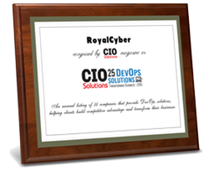
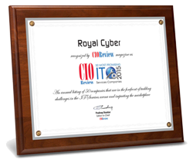
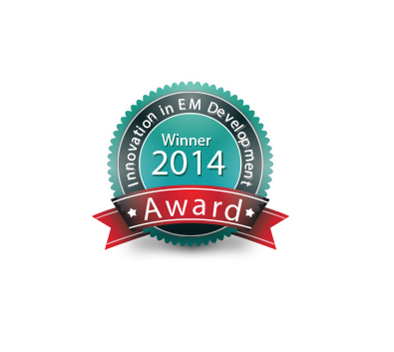
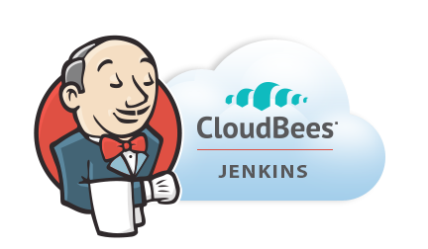


Awards & Recognition

Slide 27




































Clientele
Integramark

Slide 28
Global
Infrastructure
Relationship
Quality
Solutions
US Headquarters
Royal Cyber
55 Shuman Blvd, Suite 275, Naperville, IL 60563 USA.
Tel: +1.630.355.6292
Australia Office
Royal Cyber
Suite 504, 365 Little Collins Street, Melbourne
Victoria 3000, Australia.
Tel: +613 9021 6896
South Africa Office
Royal Cyber Pty Ltd.
3rd Floor, 5 Sturdee Ave 2196, Rosebank,
Johannesburg, Gauteng, South Africa.
Tel: +27 10 500 8120
India Office
Chennai
Hallmark Towers, 7th Floor,
No: 35 (SP), Developed Plot Estate,
Guindy, Chennai , India – 600032
Tel: +91 044 4266 7042
UK Office
RC Technologies Limited
20-22 Wenlock Road, London, UK N1 7GU
Tel: +44 203 818 5902
Canada Office
Royal Cyber Technology Inc.
1285 W Broadway #600,
Vancouver, BC V6H 3X8
Tel: +1.416.549.1646
Saudi Arabia Office
Office # 301, 3rd floor, Building Prince Nouf, Salah Uddin street,
AlMalaz district
P.O Box 2504, Riyadh 12214
Tel: +966 11 461 1906
Bangalore
#150, Tower A, Lower Ground Floor,
Diamond District, Old Airport Road,
ISRO Colony, Domlur, Bengaluru – 560008, India
Tel: +91 08040983128

